Slide 1
GBM vs. XGBoost vs. LightGBM
Chris Kuo, Ph.D.| Columbia University

Slide 2
Regularization
Overfitting can happen when a model learns the data too well including background noise. A seemingly nice model will result in poor prediction.
Methods to mitigate overfitting problem:
Data validation approach (cross-validation, leave-one-out, etc.)
Regularization (LASSO, Ridge, Elasticnet)
Bias-variance tradeoff: a model with very small bias may include too many variables thus over-fits the data. A model either has a large number of variables, or large magnitude of coefficients.
Regularization adds a penalty term to the loss function to penalize large number of coefficients or large magnitude of coefficients.

Slide 3

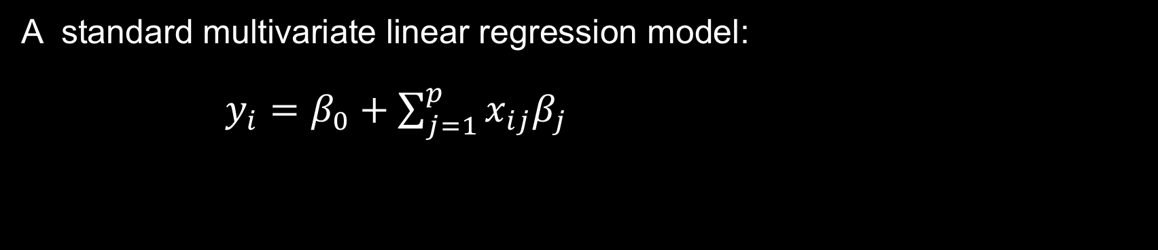
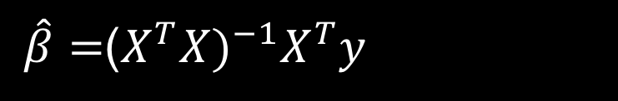
No Regularization
A standard multivariate linear regression model:
$y_{i}=β_{0}+\sum_{j=1}^{p}{x_{ij}β_{j}}$
$\hat{β}=$($X^{T}X)^{−1}X^{T}y$

Slide 4

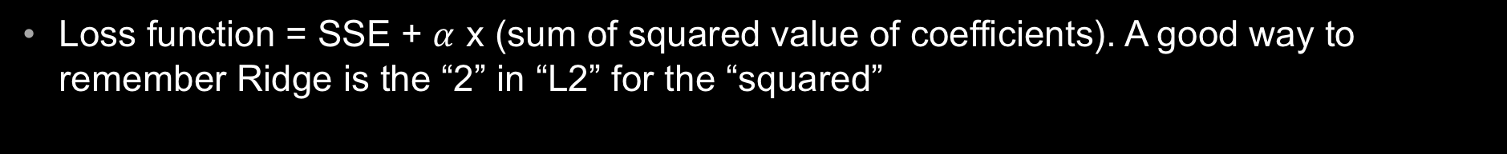
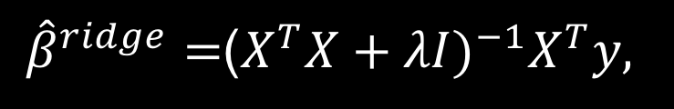
Regularization – Ridge (also called L2)
Loss function = SSE + $α$ x (sum of squared value of coefficients). A good way to remember Ridge is the “2” in “L2” for the “squared”
Here λ ≥ 0 is a complexity parameter that controls the amount of shrink- age: the larger the value of λ, the greater the amount of shrinkage. The coefficients are shrunk toward zero (and each other). The idea of penalizing by the sum-of-squares of the parameters is also used in neural networks,
${\hat{β}}^{ridge}=$($X^{T}X+λI)^{−1}X^{T}y,$

Slide 5
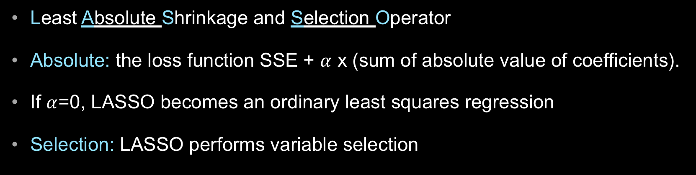
Regularization – LASSO (also called L1)
Least Absolute Shrinkage and Selection Operator
Absolute: the loss function SSE + $α$ x (sum of absolute value of coefficients).
If $α$=0, LASSO becomes an ordinary least squares regression
Selection: LASSO performs variable selection

Slide 6

Regularization – ElasticNet
Zou and Hastie (2005) introduced the elasticnet penalty
The elastic-net selects variables like the lasso, and
Shrinks together the coefficients of correlated predictors like ridge.
It also has considerable computational advantages over the L1 or L2 penalties.
Elasticnet
=

Slide 7
Regularization
Jerome Friedman Trevor Hastie:” Ridge regression is known to shrink the coefficients of correlated predictors towards each other, allowing them to borrow strength from each other.
In the extreme case of k identical predictors, the variables each gets identical coefficient with 1/kth. LASSO, on the other hand, tend to pick one and ignore the rest.
Ridge reduces the magnitude of coefficients close to zero; in contrast, LASSO reduces the magnitude of coefficients exactly to zero. Therefore LASSO works like a feature selector that picks out the most important coefficients.

Slide 8
GBM/XGB/LightGBM

Slide 9
GBM vs. XGB vs. LightGBM
 | GBM | XGBoost | LightGBM
Full name | Gradient Boosting Machine | eXtreme Gradient Boosting | Light GBM
Data size | Medium | Large | Large
Training speed | Medium | Fast | Fast
Parallel Processing |  | Supported | Supported
Regularization |  | Yes
Overfitting | Likely | Controllable | Relatively serious
Author/contributor | Jerome Friedman | Tianqi Chen | Microsoft

Slide 10
XGB Features
Regularization: Xgboost used a more regularized model formalization to control over-fitting, which gives it better performance.”- Tianqi Chen
Speed: Computation in C++
Parallel process:
The algorithm was developed to efficiently reduce computing time and allocate an optimal usage of memory resources.
Block Structure to support parallelization in tree construction and the ability to fit and boost on new data added to a trained model
Faster in GBM in general
Important features of implementation include handling of missing values (Sparse Aware),
Faster training speed and higher efficiency

Slide 11
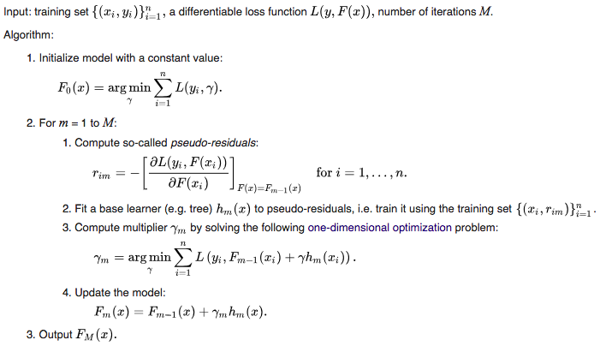
GBM In pseudocode

Slide 12

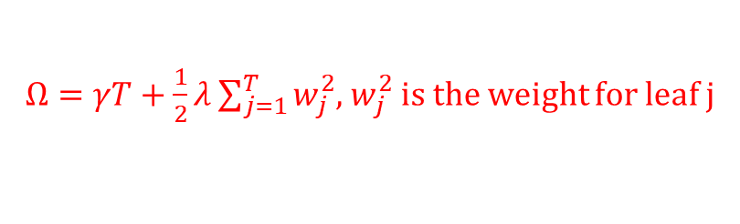
XGB In pseudocode
Objective function = Loss + Regularization
+ $Ω,$
$Ω=γT+\frac{1}{2}λ\sum_{j=1}^{T}{w_{j}^{2}}$, $w_{j}^{2}$ is the weight for leaf j
Since we don't have derivative for every objective function, we calculate the second order taylor approximation of it

Slide 13
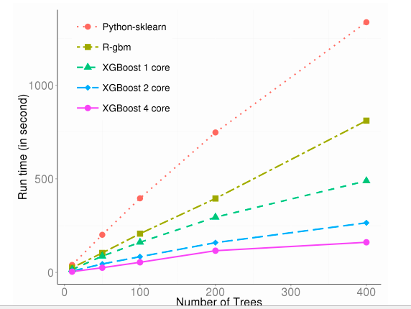
XGB runtime

Slide 14
LightGBM
Features:
Faster training speed and higher efficiency
Lower memory usage
Compatibility with large datasets
Parallel learning supported
Better accuracy than GBM/XGB

Slide 15
LightGBM
Leaf-wise to get higher level of accuracy
Tend to over-fit when data size is small
Use parameter max_depth to limit the depth of tree <=3
Level-wise tree growth
Leaf-wise tree growth

